Slide 1


URBAN ECO PLANNER

Slide 2



Contents
03/
Project as
a solution
05/
Business
Model
01/
Introduction
04/
Features
02/
Problem Statement
04/
Features
06/
Future Work

Slide 3
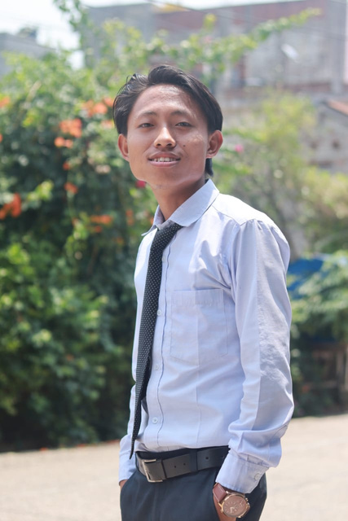
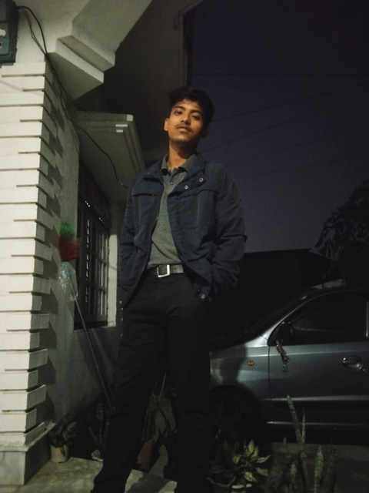




Team Members
Rabin Rai
Kshitiz Chaudhary
Jeeban Giri
Mandip Timalsina

Slide 4
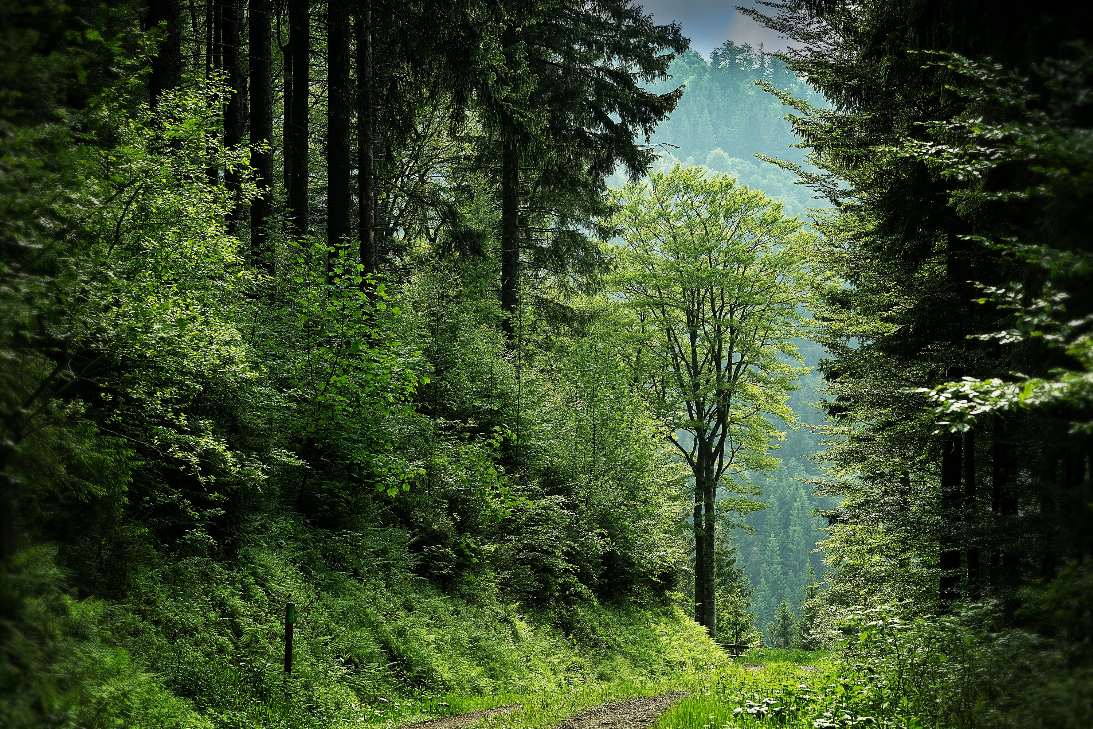
Urban Eco
Planner
Urban Eco Planner website. supports the idea to make a world a better healthy and clean place in a fun way.
By providing a various challenges to the local people and a prize pool.

Slide 5
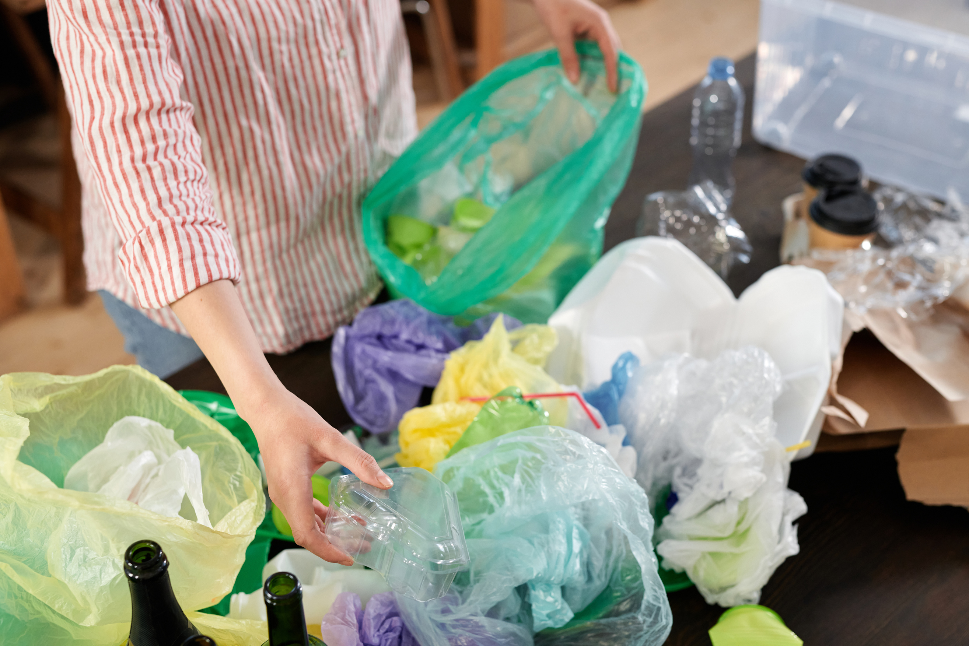
PROBLEM
STATEMENT
In modern world, the waste management is being extremely hard to manage the waste especially in the developing countries like Nepal.

Slide 6
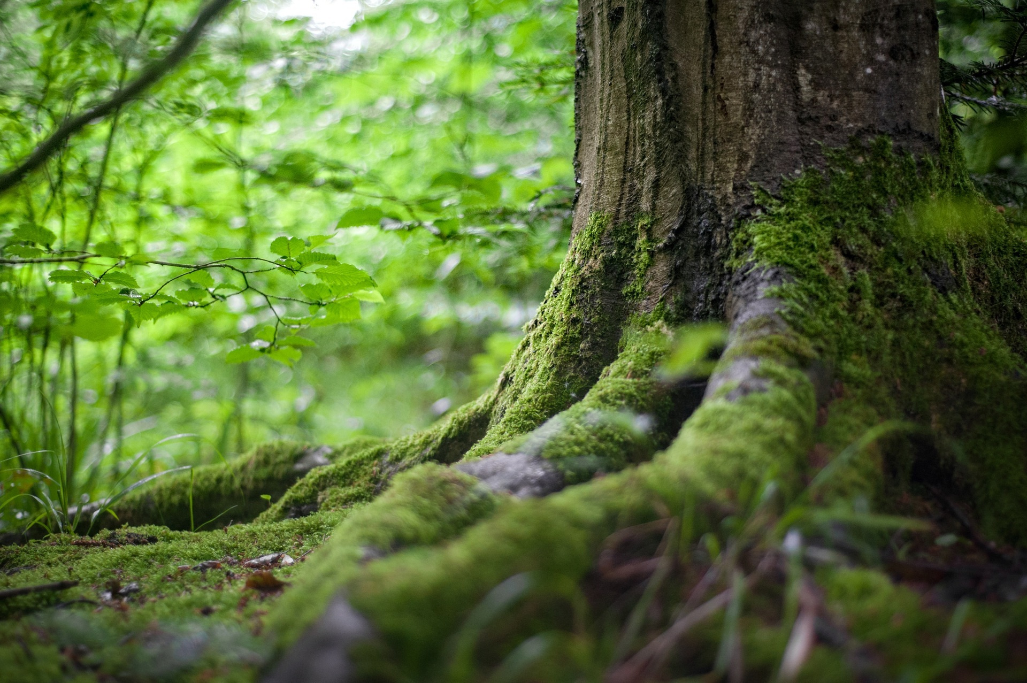
Project as a Solution
Urban Eco Planner motivates the local people of villages and city to clean their surrounding as there is the prize amount donated by ward chief to the village that complete the challenges effectively for development activities.

Slide 7
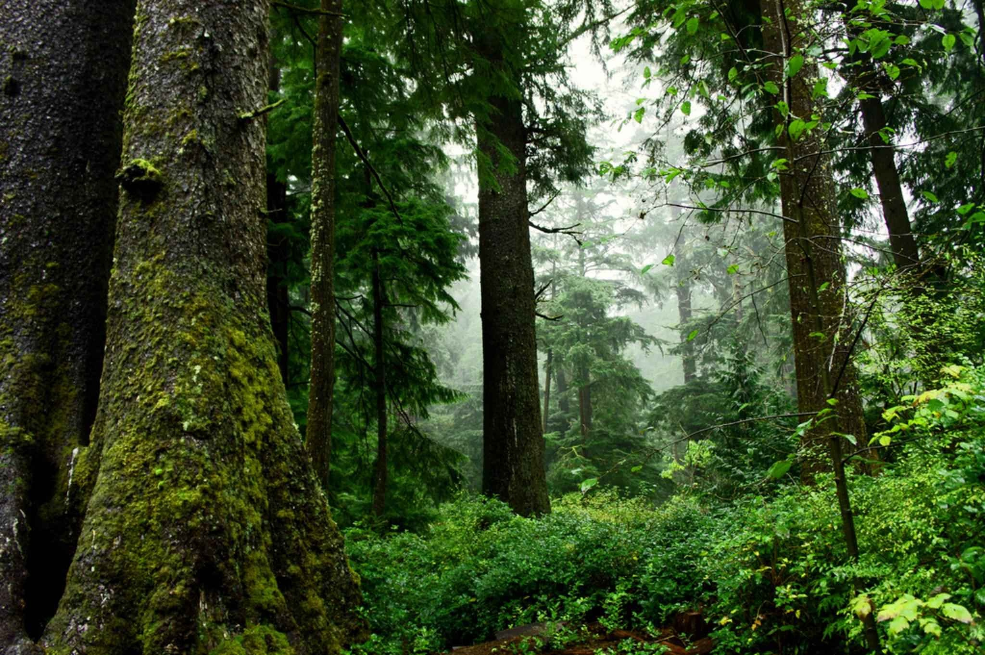




Features
Monthly challenges to the people
Share a various knowledge and ideas by uploading a blog
Customer can veiw and edit their profile

Slide 8

BUSINESS MODEL
Customer relationships
Key Activities
To-do list
Rank Promotion
Upload post
Prize Money
Customer segments
Key Partners
Value Propositions
Adults
Elders
Ward chief
Easy to use
Village Commitee
Clean Environment
Improve health
Key Resources
Channels
Monthly Challenges
Social Media
Advertisement
Cost Structure
Revenue Streams
Advertising
Advertisement
Marketing
Sponsors
Maintaining a website

Slide 9


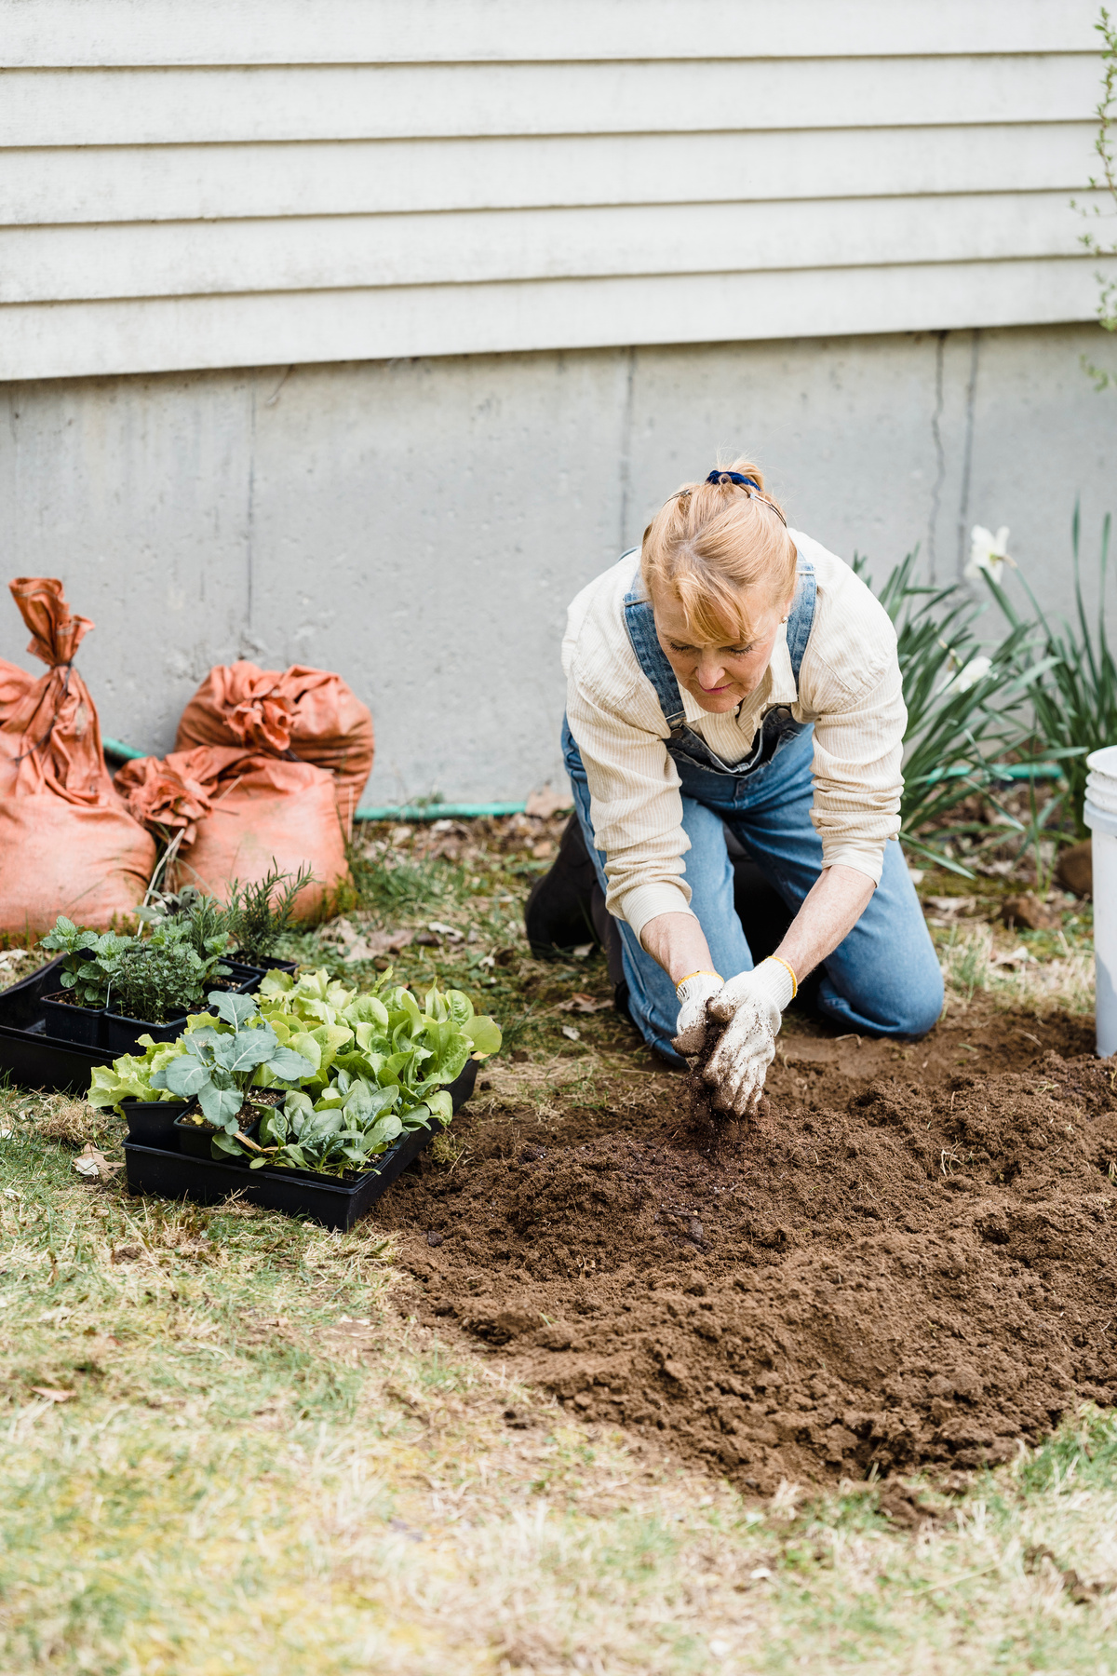

Future Work
In future, we can add a features
Like online payment system.
We can expand a list of villages and city.

Slide 10


ANY
QUESTIONS?

